Slide 1
Multiplying Fractions
Year 7
Week 5
Lesson 2

Slide 2
Mental Maths
Which fraction is larger: 1/3 or 1/4
What is 86% as a fraction?
Is a the numerator or denominator? a/b
4 x 11 =
1/4 + 2/4 =
1/3
86/100
numerator
44
3/4
Notes:
• Share with students what they are learning or will be able to do
• Why the lesson is important

Slide 3
Last Lesson Recap
Notes:
• Share with students what they are learning or will be able to do
• Why the lesson is important

Slide 4
Lesson Objective
By the end of the lesson I will:
Know how to multiply fractions correctly

Slide 5
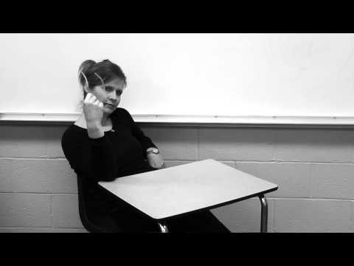
Notes:
https://youtu.be/4ghdMifXuFE

Slide 6
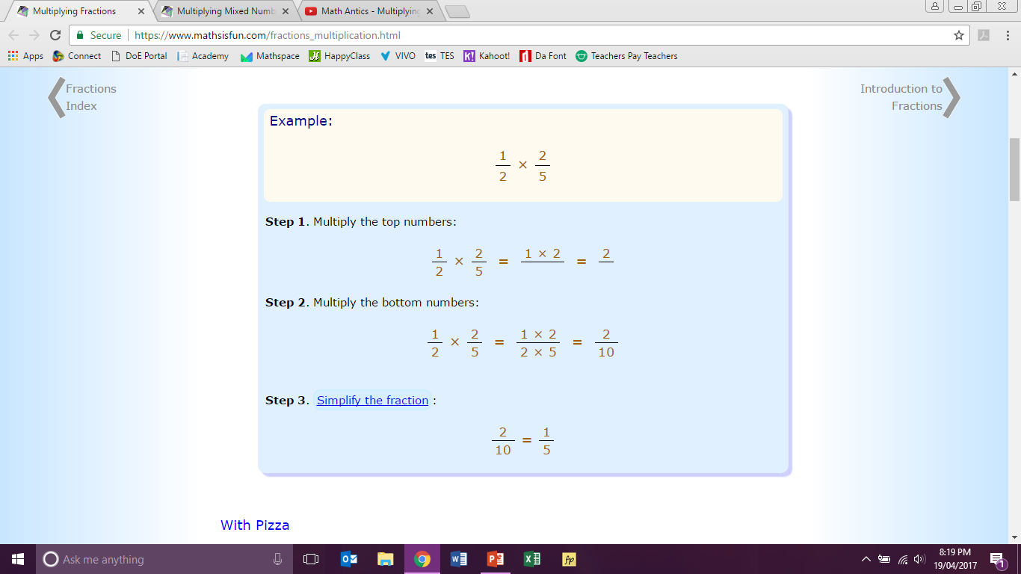
24
7
30
Topic: Multiplying Fractions
Date
EQ – How do you multiply fractions?

Slide 7

24
7
30
Topic: Multiplying Fractions
Date
EQ – How do you multiply fractions?

Slide 8
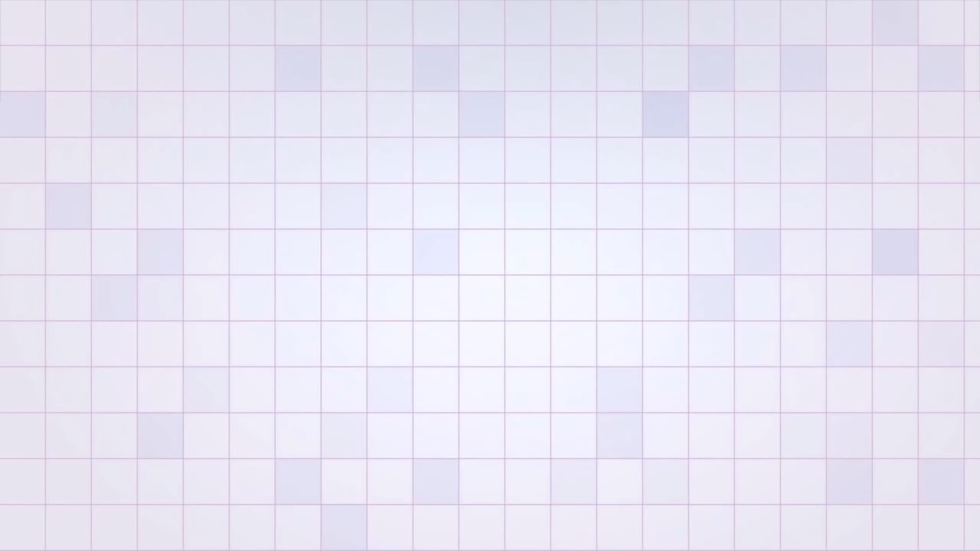

Slide 9

Examples
$\frac{2}{3} × \frac{3}{5} =$
$\frac{3}{4} × \frac{2}{5} =$
Notes:
• Give students the opportunity to practise with teacher guidance
• Provide immediate and specific feedback with knowledge of results

Slide 10

Examples
$$\frac{1}{3} × 1\frac{1}{2} =$$
8 $× 1\frac{5}{6} =$
Notes:
• Give students the opportunity to practise with teacher guidance
• Provide immediate and specific feedback with knowledge of results

Slide 11
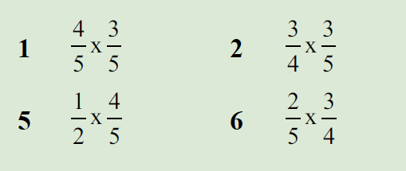
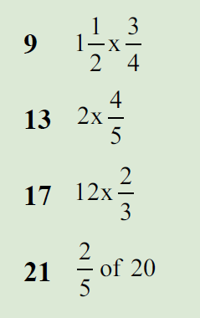
Task
FREEFALL WORKSHEET
Notes:
• Give students the opportunity to practise with teacher guidance
• Provide immediate and specific feedback with knowledge of results

Slide 12
Exit Ticket
Complete the Exit Ticket and give to me at the door when you leave

